Slide 1
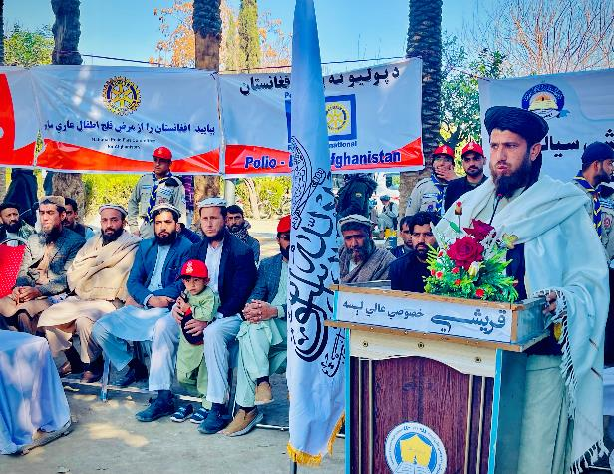
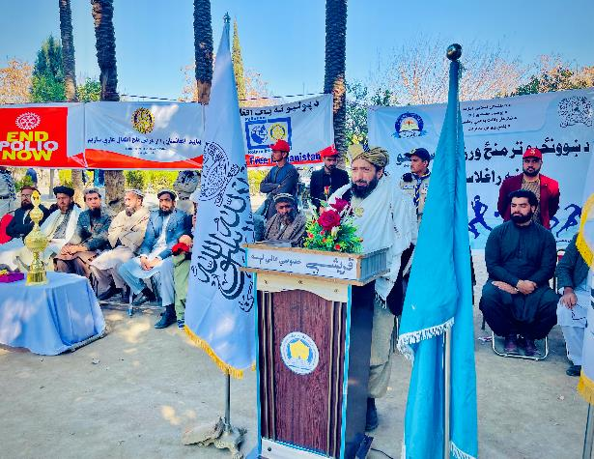
City Education Director
“Every country that has eliminated Polio has done so using Polio vaccines “
Nangarhar Education Director
“ Polio vaccine is the Only way to prevent Polio infection”.
They said share Polio awareness messages with friends, families and loved ones in the neighbourhood ... Polio Free Afghanistan

Slide 2
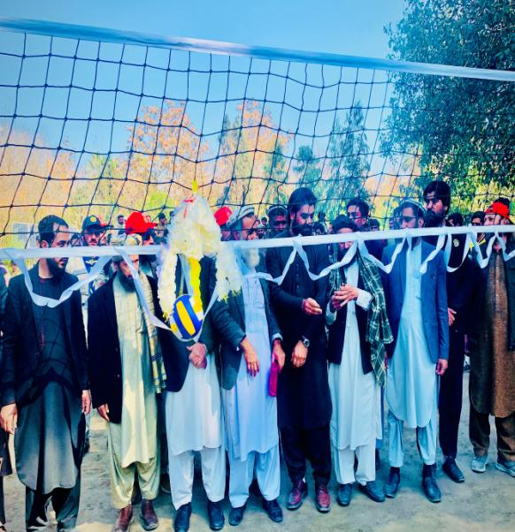
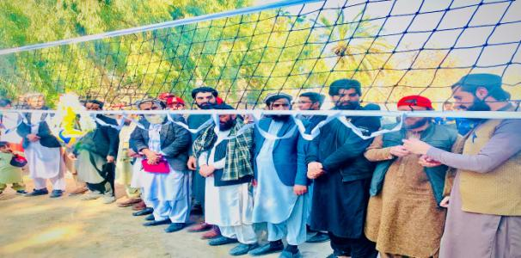
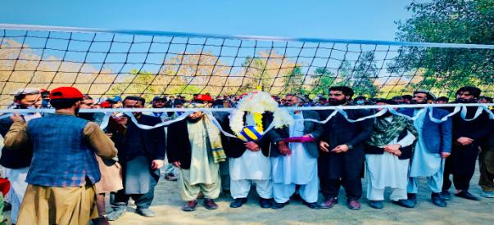
Education director and officials and PolioPlus staff, TETT & AYC members during volleyball tournament opening event

Slide 3
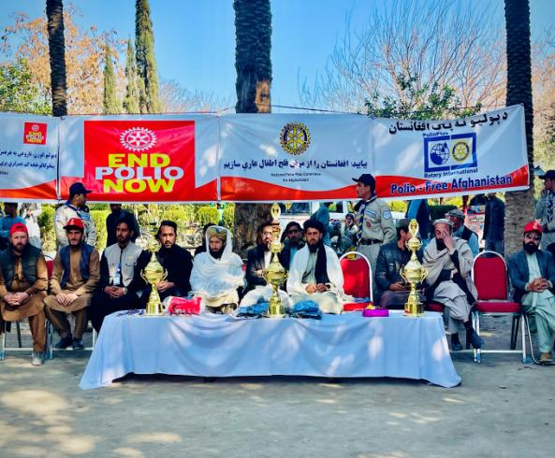
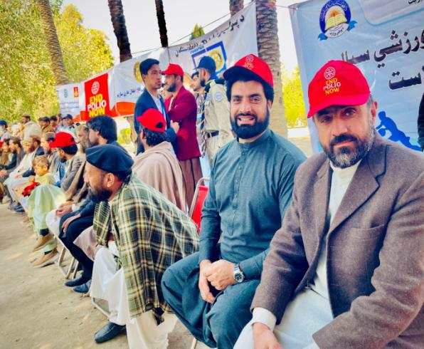
Kick out Polio in Afghanistan, get your child vaccinated!
Education department and schools officials
Mr. Almas and Mr. Fazal

Slide 4
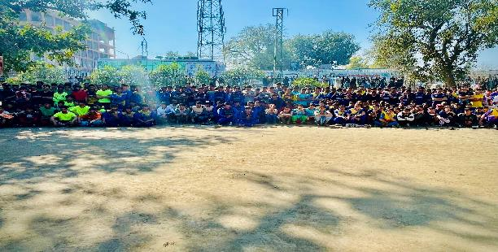
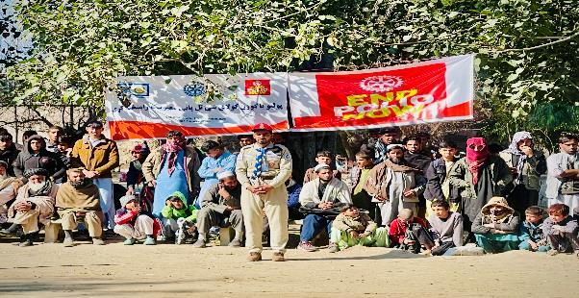
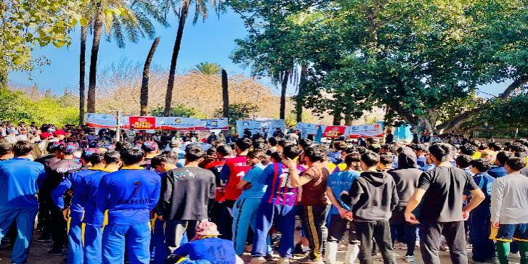
Get a Polio Drop, STOP the Strop

Slide 5
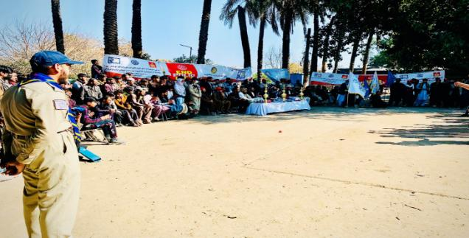
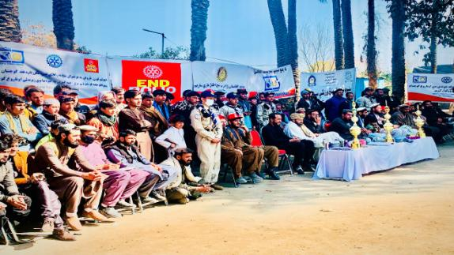
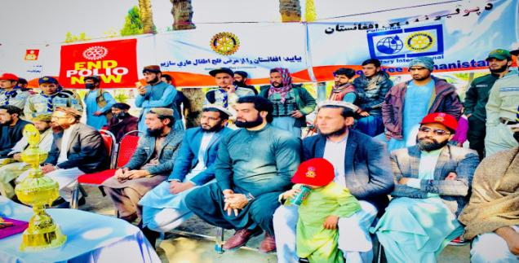
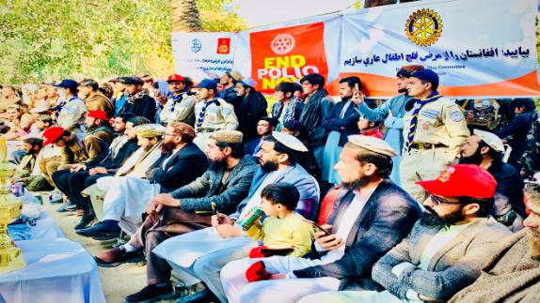
Hundreds of people are aware now about Polio Vaccination

Slide 6
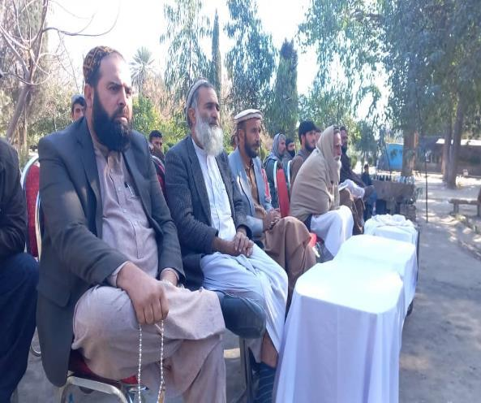
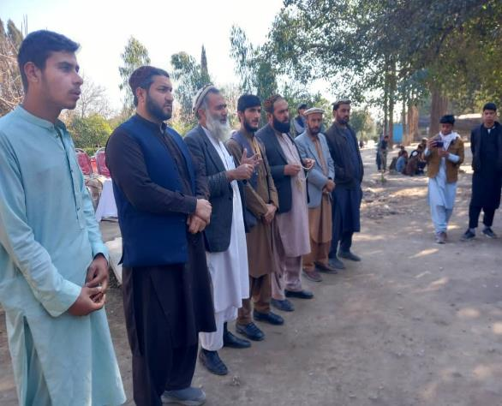
Sport department officials
“Lets do our part. Vaccinate your kids on time”.

Slide 7
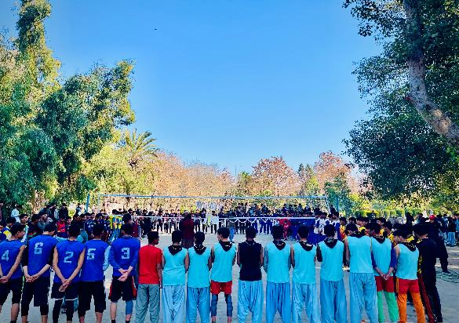
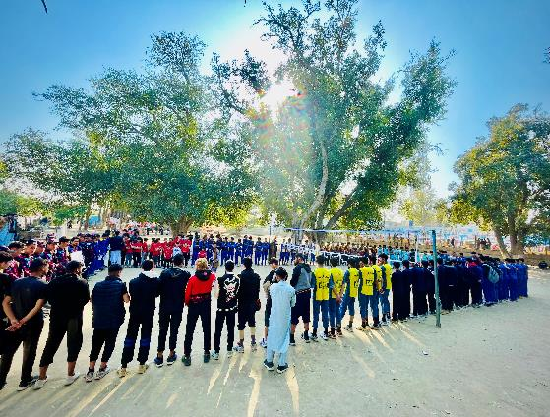
Players “ Polio is a highly infections disease that causes lifetime paralysis in Non – Vaccinated Children”
There is no cure for polio, but it is preventable with the polio vaccine
Players gathered from different Schools ( Cricket, Volleyball, Gymnastic , Boxing and free fight players)
Notes:
players gathered from different Schools ( cricket, volleyball, gymnastic , boxing and free fight players)

Slide 8
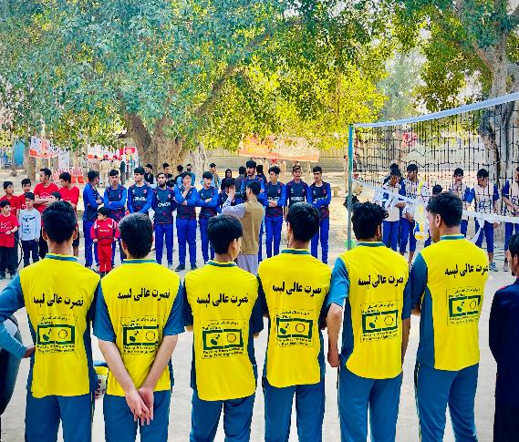
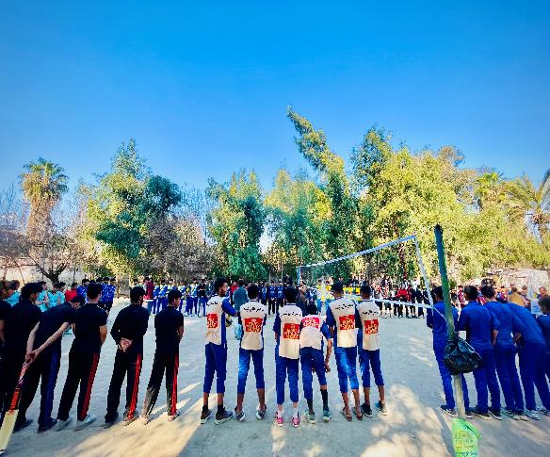
Players :- Polio Vaccination “ Keep The Afghanistan Polio Free”

Slide 9
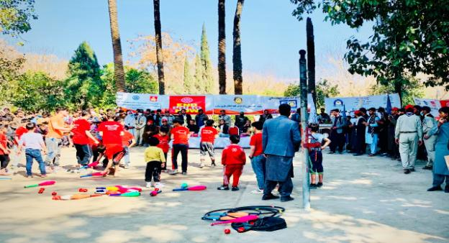
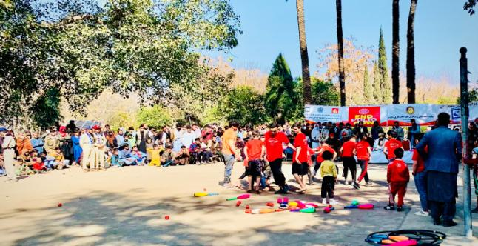
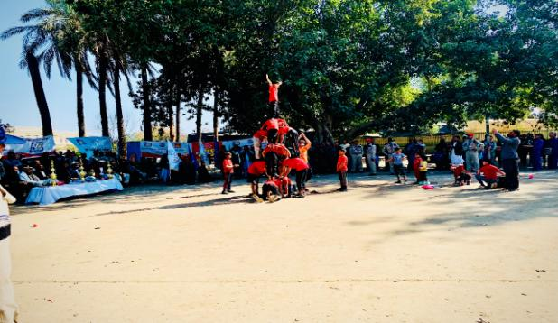
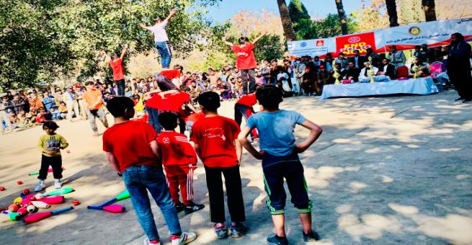
The students also presented and showcased the gymnastics and kickboxing moves and tactics to the audience which was appreciated and enjoyed by all.
Notes:
Gymnastic players are doing different movements

Slide 10
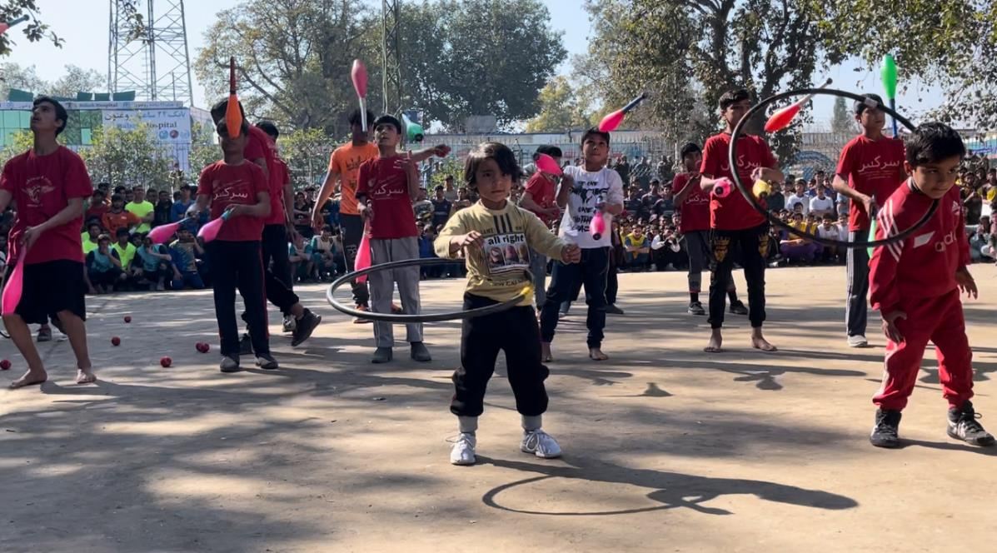
END POLIO NOW
Gymnastic players are doing different movements

Slide 11
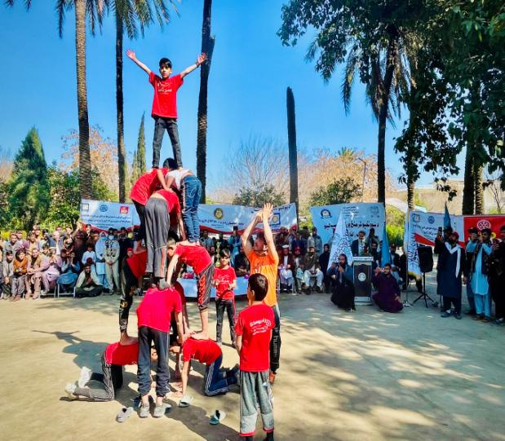
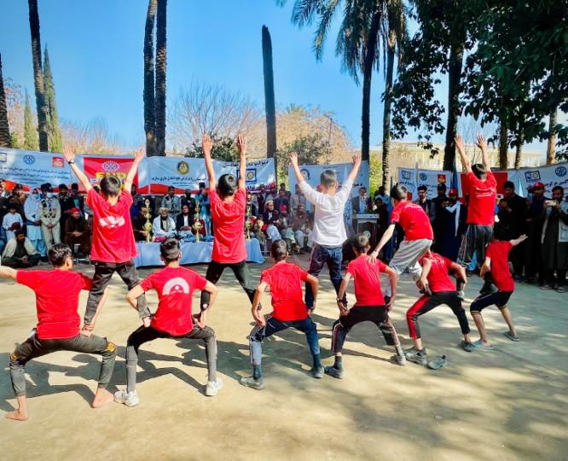
The students presented and showcased the gymnastics and kickboxing moves and tactics to the audience which was appreciated and enjoyed by all.

Slide 12
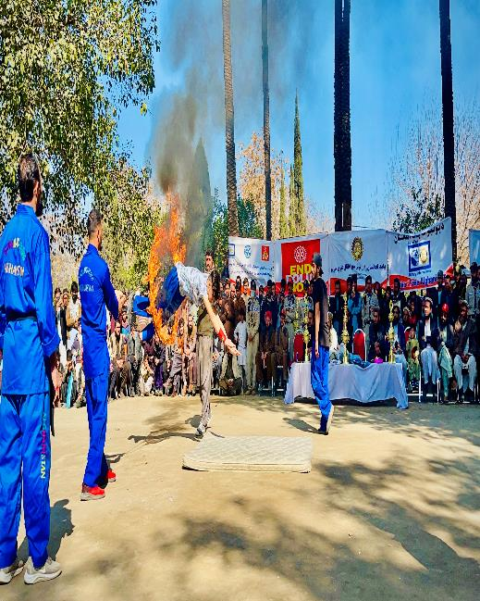
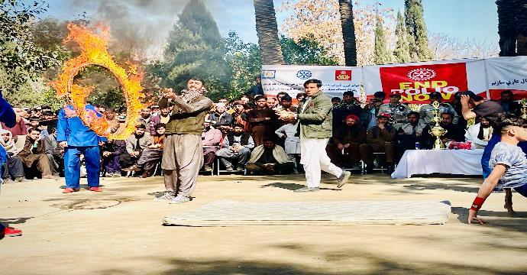
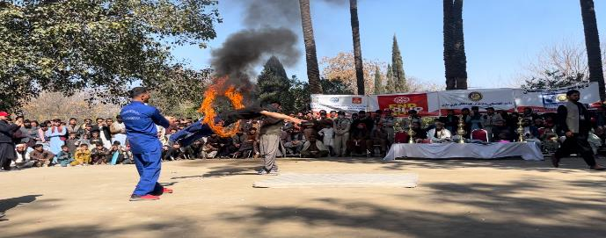
The boys are doing gymnastics and kickboxing movement during exhibition
Notes:
The boys are doing gymnastics and kickboxing movement during exhibition

Slide 13
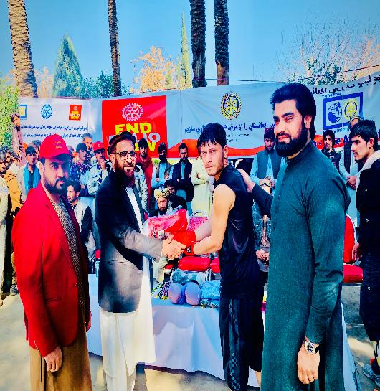
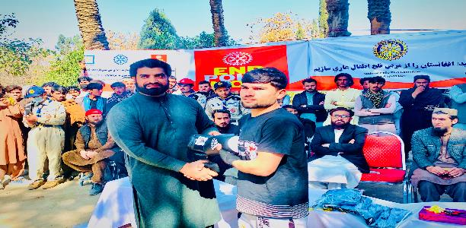
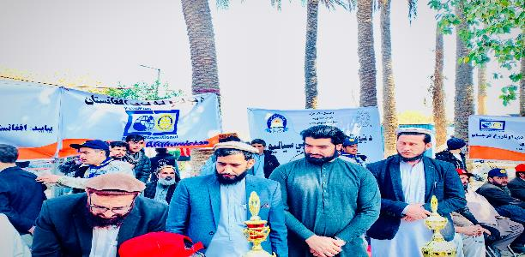
Distributed award, trophy , prize to the best player of the game
Notes:
Distributed prize to the best player of the game

Slide 14
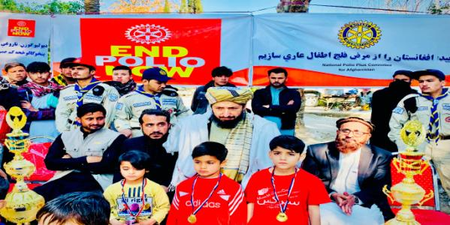
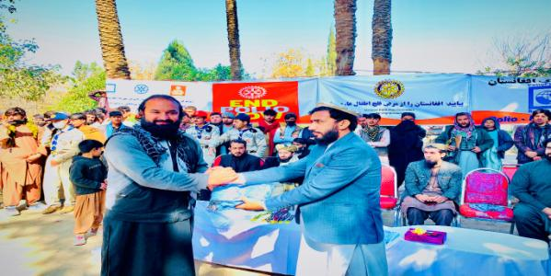
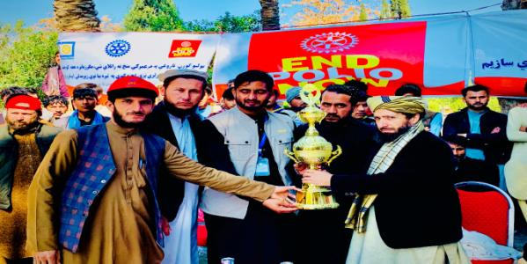
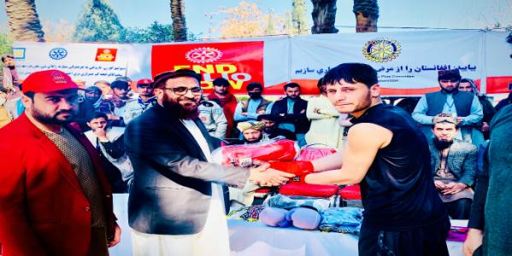

Slide 15
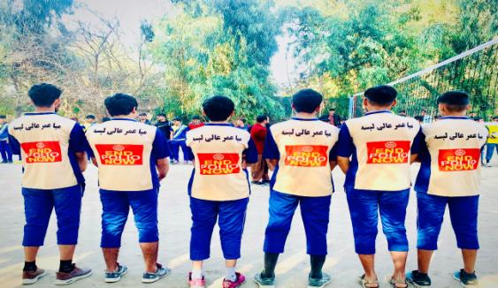
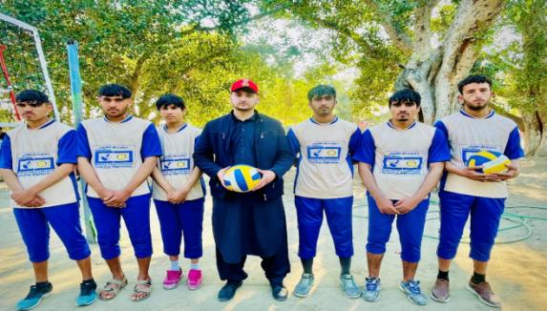
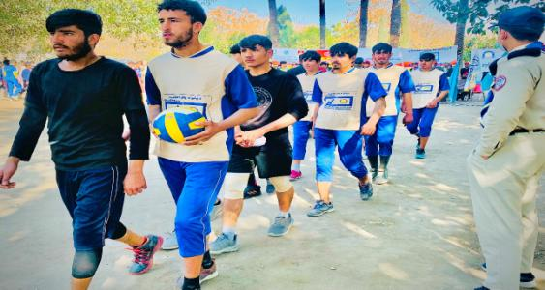
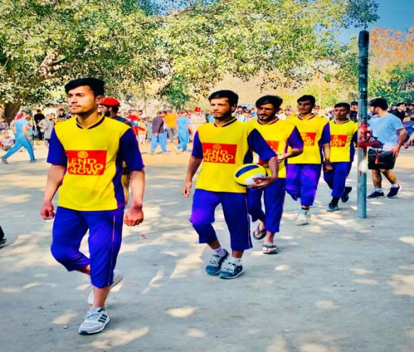

Slide 16
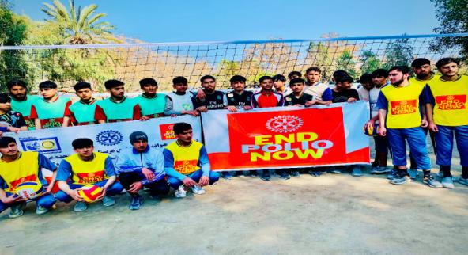
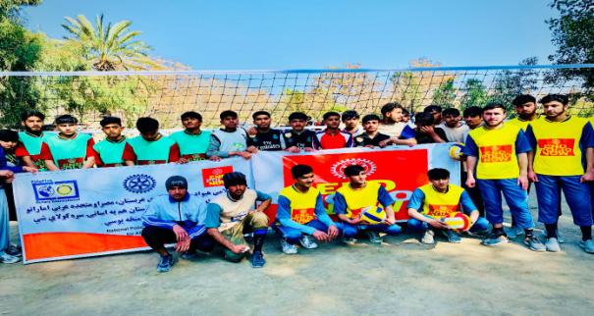
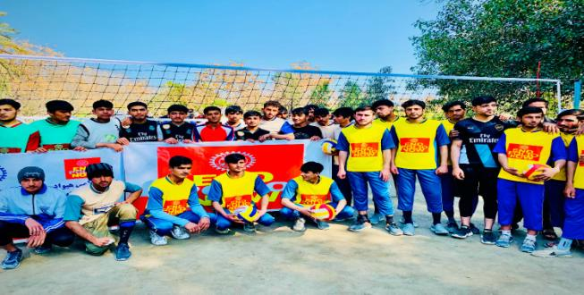
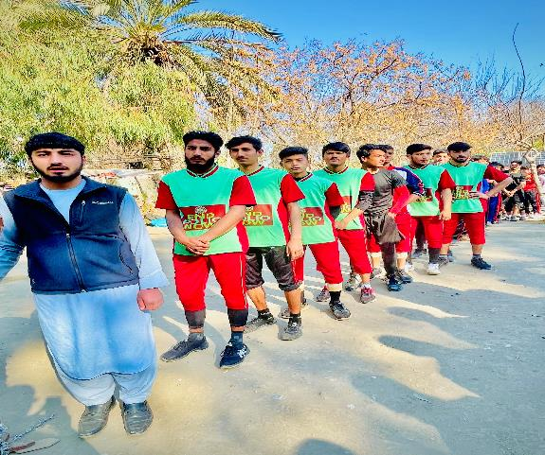
Notes:
First game of the tournament

Slide 17
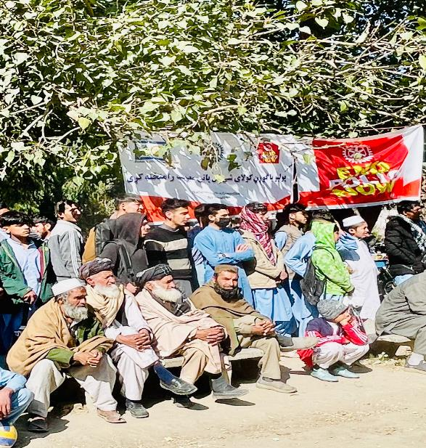
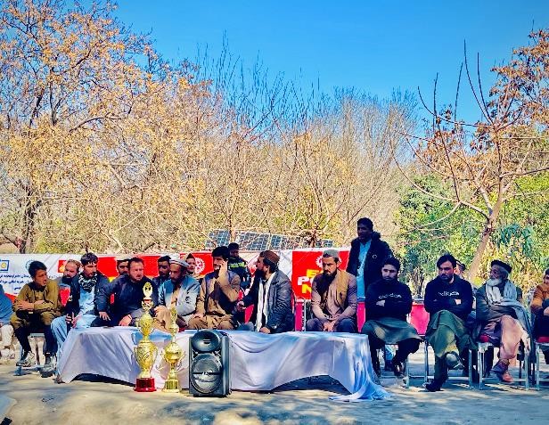

Slide 18
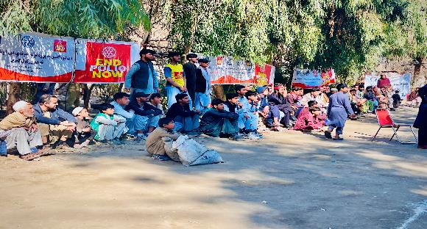
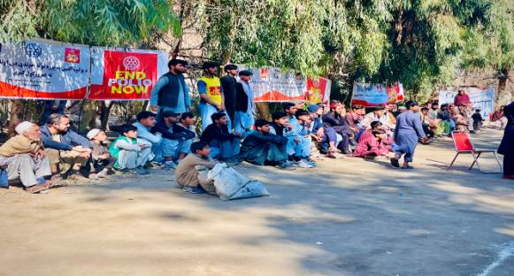
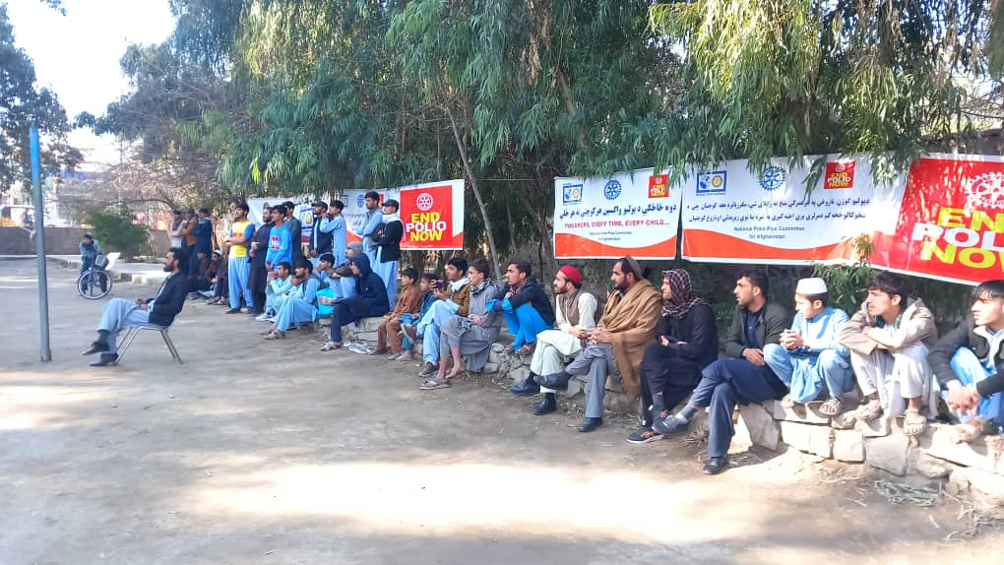


Slide 19


Hundreds of people are aware now and will share the message with their friends, families and loved ones in the neighbourhood about polio eradication

Slide 20





Slide 21





Slide 22




Slide 23





Slide 24


PolioPlus, TETT & AYC staff appreciation by Education department officials
Notes:
Taking appreciation letters

Slide 25




Mr. Matiullah and Mr. Ihsan are giving Medals to the best players of the tournament
Notes:
Mr. Matiullah and Mr. Ihsan are giving Medals to the best players of the tournament

Slide 26
Thank You!
Fight Polio For A Better Tomorrow.

